Slide 1

Promotional Offer Analysis and Stock Forecasting at a Supermarket
INDIAN INSTITUTE OF TECHNOLOGY MADRAS
BUSINESS DATA MANAGEMENT CAPSTONE PROJECT
NAME: YUKTI SETHI

Slide 2
Organisation background
Established in 1999
Both B2B and B2C
2 branches
12 employees: 2 accountants and 10 labourers.
Timing: open everyday 10 AM to 10 PM
Offerings: Free home delivery to local customers in Okhla.

Slide 3
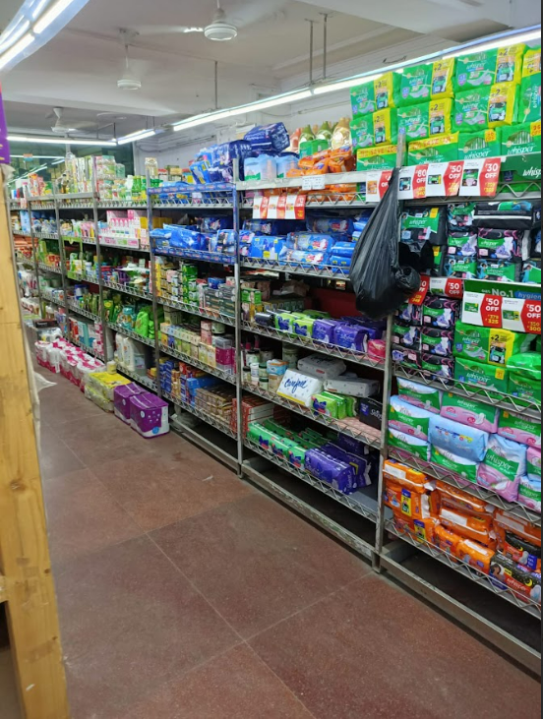
Problem Objectives:
To improve the effectiveness of its promotional offers and discounts in sales.
To forecast the stock based on the sales data.

Slide 4
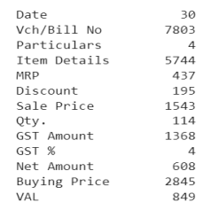
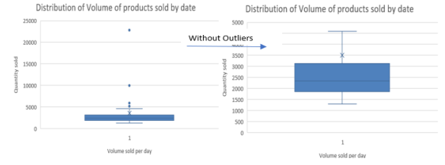
Data cleaning and preprocessing
Handling missing values
Handling outliers-27% from NGOs
Handling Incorrect values
SKU categorisation (5744 →40)

Slide 5
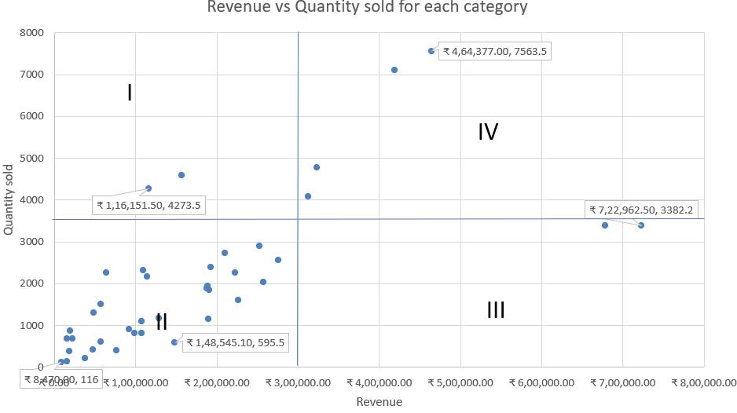
Revenue vs Sales volume
I= Low-revenue-high-volume items = Biscuits
II=Low-revenue-low-volume items = Stationary
III=High-revenue-low-volume items = Dry Fruits
IV= High-revenue-high-volume items = Dairy Products

Slide 6
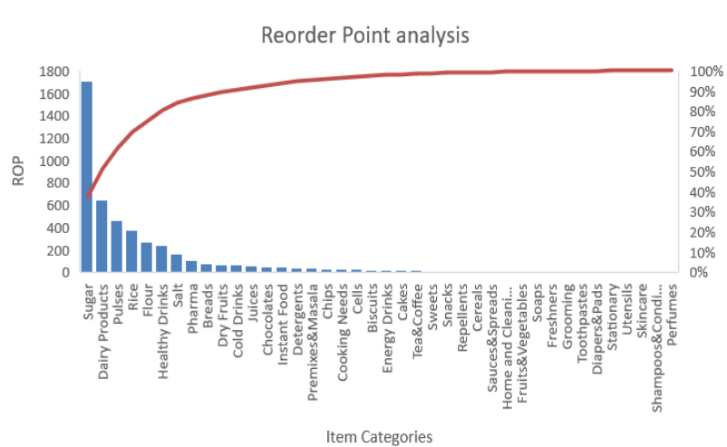
REORDER POINT ANALYSIS
Reorder Point = Lead time demand × Average daily sales + Safety stock
Average lead time =14 days.
Average daily sales = Total quantity bought / Time period (30 days).
Lead time demand =Lead time× Average daily sales
Safety stock = Maximum sale in a single day × Maximum Lead time – Lead time demand
Sugar: 1700 Units
Dairy Products: 600 units
Pulses:400 Units

Slide 7
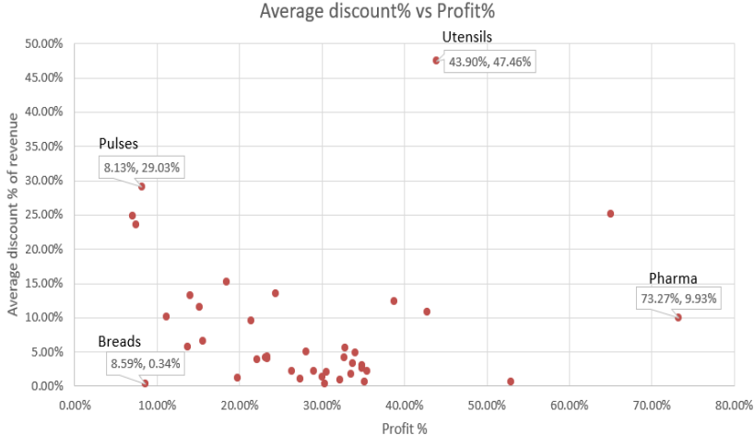
Discount vs Profit
Pulses - large discount of 29%, low profit of 8%! Eating away of profit margins?
‘Breads’ - low profit and low discounts.
Pharma’ - high profit of 73.27% , low discount of 9.93%! Strong demand good-going products.
Utensils – an equal portion of discount and profit. (highest discount but not the highest profit relatively).

Slide 8
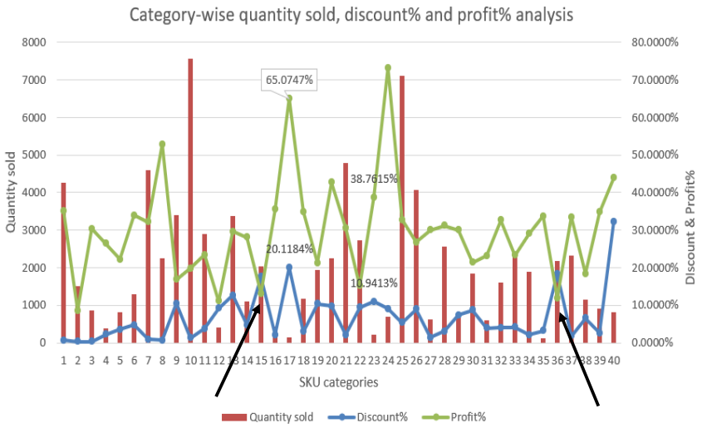
Quantity sold vs discount vs profit analysis
Fruits and vegetables have high discount (20%), high profit (65%) but low sale volume (143 units).
Flour and Sugar – high discount (17%), low profit(12%), low sales. (15 and 36 in the chart)

Slide 9
Interpretation of Results
Utensils (26.4% of total discount – highest!) 10% of total volume –ineffective. Market saturation?
Breads and cakes - no discount , contribute to only 10-15% of the total sales.
About half of the items (perfumes, fresheners, soaps, repellents) - do not require a special focus on stock.
Pulses, Dairy Products and Premixes, and Masalas - 60% of the total sales volume- high-volume!
‘Stationary’ constitutes low-revenue low-volume products proving to be invaluable.
Flour and Sugar, with a discount percentage of 17% but a profit of only 13% is eroding the profitability.
Fruits and Vegetables - high profit of 65%, high discount of 20% but low sales! Quality issue?
Pulses - large discount of 29%, low profit of 8% but high sales! Eating away of profit margins but increasing revenue. Compensatory performance.
Dry Fruits- Premium products. Prioritize stock commitment of at least (64 units).
Trend analysis - Weekend offers. Month start and ending offers. Stock commitment is essential.

Slide 10
Recommendations
Creating a website for the store – Attractive discounts!
Pulses, Fruits and vegetables, Dairy Products, Cereals= 1x increase in discount = 2x decrease in profit! Quality issue in edible products? Desperately meeting the shelf life deadline?
Membership – small fee to customers, special discounts on high-selling products.
Products like bread and cakes = clustered discount offerings (high profit and low sale products)
Small store – 8 labourers keeping an eye on customers. Useless? Cut labour costs.
Free home delivery only to those who took membership.

